Slide 1

Go play with sorting algorithms here (use the one step at a time, look at the code!)
https://visualalgo.net/en/sorting

Slide 2
cs50 section 3
Algorithms
Andrew Holmes 2023

Slide 3
Today’s plan
01
Structs
03
Recursion
02
Sorting Algorithms
04
PSET
Organizing data!
Spooooky…
The fun stuff!
Looking ahead!

Slide 4
01
Structs
Organizing data!

Slide 5
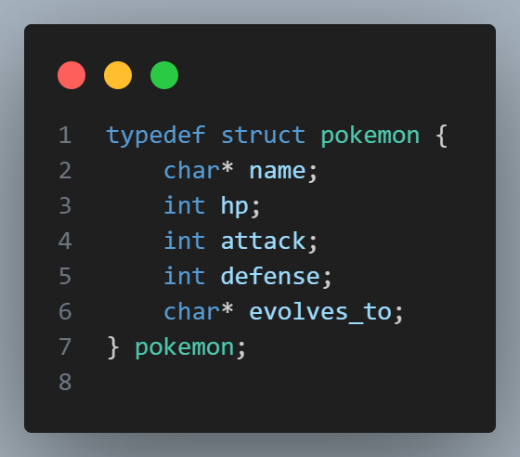
Defining a struct
Structs
Typedef – creates pokemon as a type!
Must give types and names of struct attributes.

Slide 6
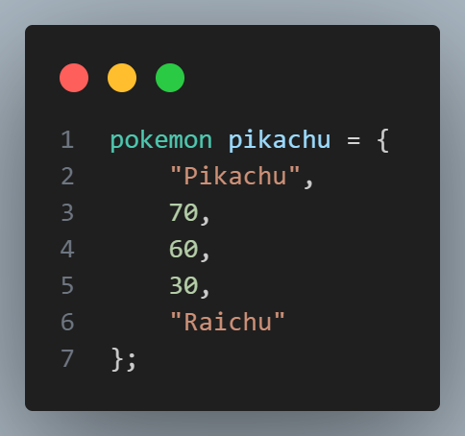
Initializing a struct
Structs

Slide 7
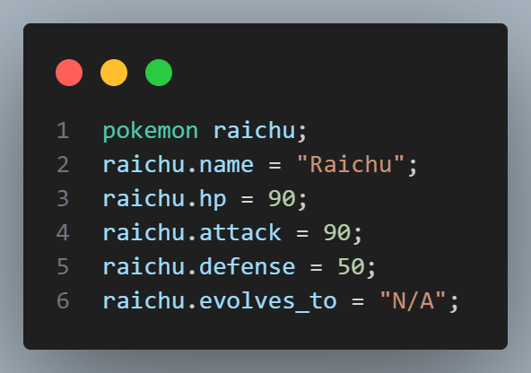
Initializing a struct
Structs
A better way to do this, so it’s clear what each data corresponds to.

Slide 8
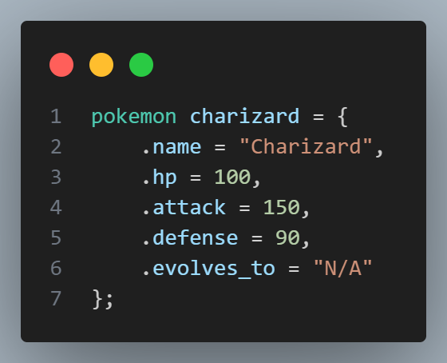

Initializing a struct
Structs
Just do it in one go, the best way, duh

Slide 9
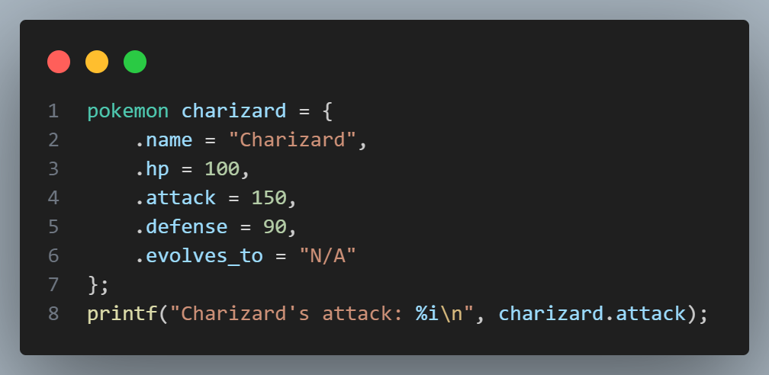
Accessing a struct
Structs
Structs use .attribute to access different parts of the struct

Slide 10
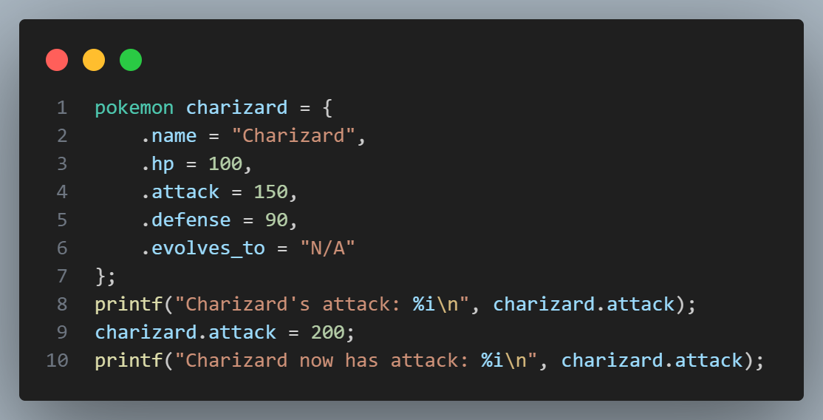
Assigning to a struct
Structs
Behaves like a normal variable!

Slide 11
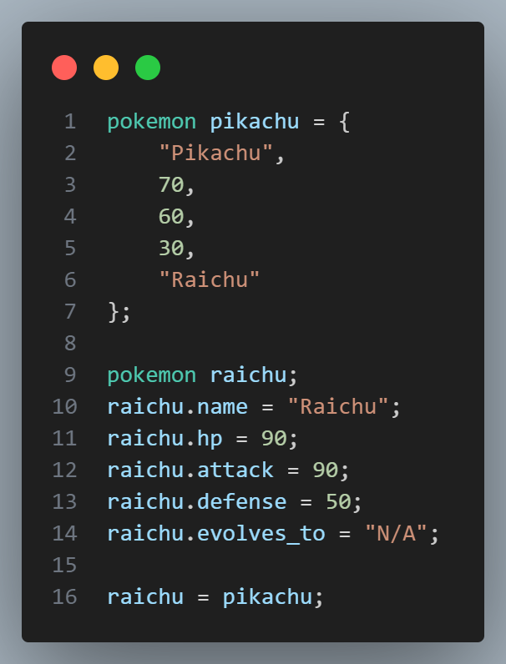
Assigning to a struct
Structs
You can also assign entire structs just as if they were any other type! This means when sorting or moving pixels (with RGB values), you can just work with the entire struct…

Slide 12
Struct layout investigation
Structs
Q: What do you think the size of this struct is? Try it yourself: create this struct, and use C’s sizeof function to find out! Why do you think that might be?

Slide 13
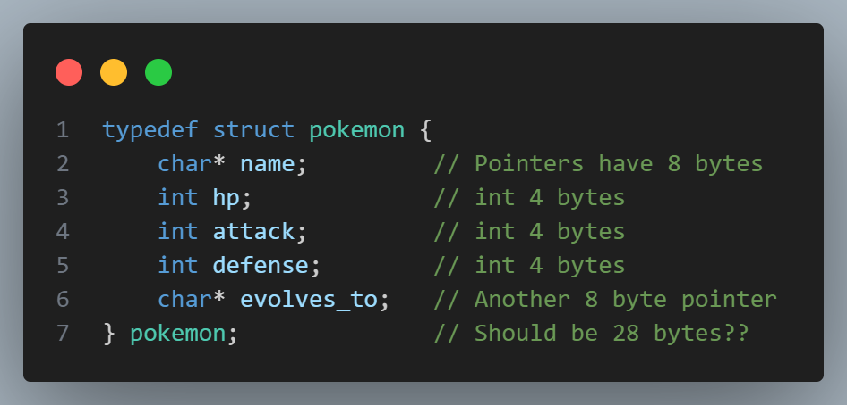
Struct layout investigation
Structs

Slide 14
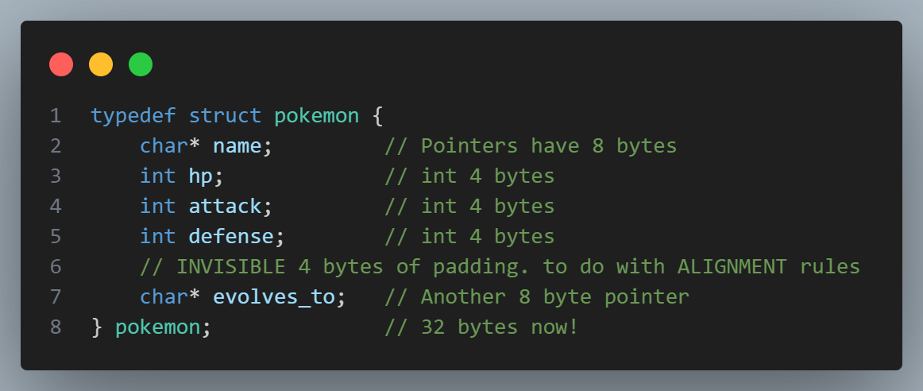
Struct layout investigation
Structs

Slide 15
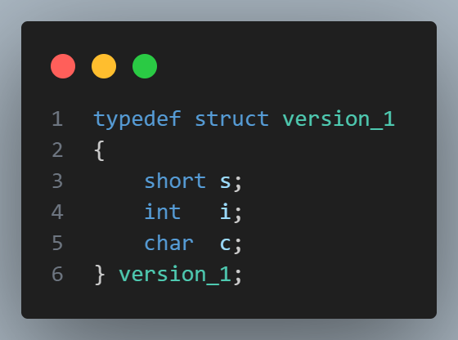
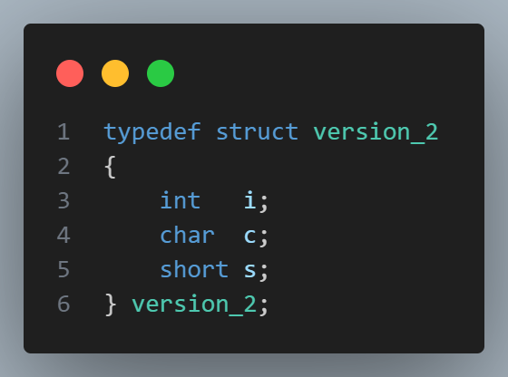
Struct layout investigation
Structs
Q: Are these two the same size?

Slide 16




Arrays
In pairs, tackle ‘temps’:
Sort the cities by average temperature to practice a sorting algo + structs.
See Slack for instruction file.
Practice!

Slide 17
02
Sorting Algorithms
Sorting and searching.

Slide 18

Motivation: why sort?
Sorting
Let’s consider searching! Let’s try to find 7:

Slide 19

Motivation: why sort?
1
8
3
Sorting
Now we have a sorted list. Even if we keep our linear search, we might have a new idea as to which end to start, or to try a place to start looking from.

Slide 20
Binary Search
Sorting
Can’t be here
Can’t be here
4 is less than 7, so if sorted, must be to the right!
There’s 7!
6 is less than 7, so if sorted, must be to the right!

Slide 21
Binary Search
Sorting
Can’t be here
Can’t be here
4 is less than 7, so if sorted, must be to the right!
There’s 7!
6 is less than 7, so if sorted, must be to the right!

Slide 22
Motivation: sorting
Sorting
So sorting can help us speed up finding data!

Slide 23

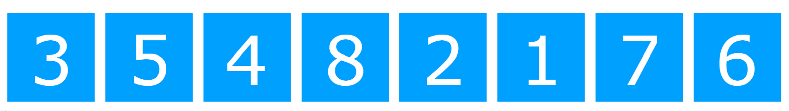
Bubble Sort
Sorting
Wrong order!
But more still to do!
Make swap – now correct order!

Slide 24
Bubble Sort
Sorting
Let’s look at bubble.c to see how I implemented bubble sort.

Slide 25
Bubble sort thoughts: too many swaps, have to swap each number many times. Let’s just swap directly to the right position!
Selection Sort!

Slide 26


Selection Sort
Sorting
Min element
Min element
Min element

Slide 27

Selection Sort
Sorting
Etc…

Slide 28
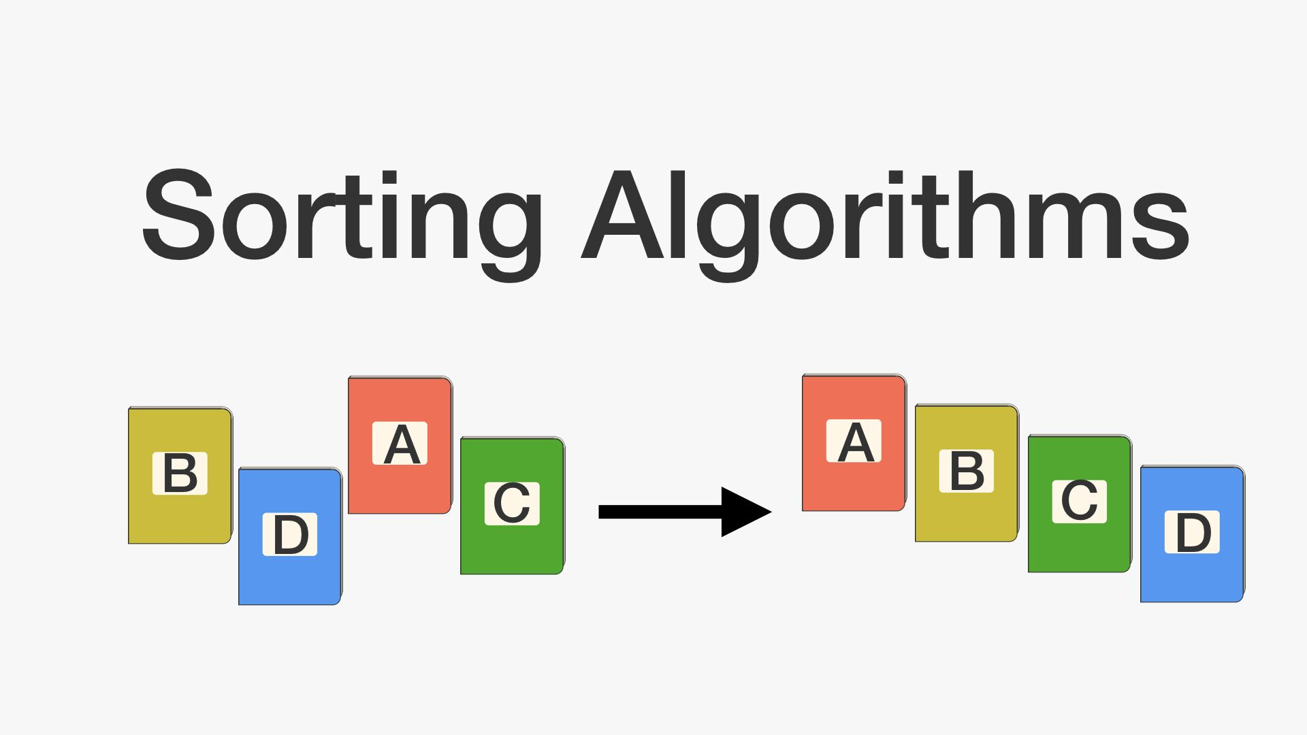
Sorting
Implement selection sort in selection.c (see Slack)
Practice!

Slide 29
Sorting
Let’s tackle the sort problem set from PSET 3 together!
Practice!

Slide 30
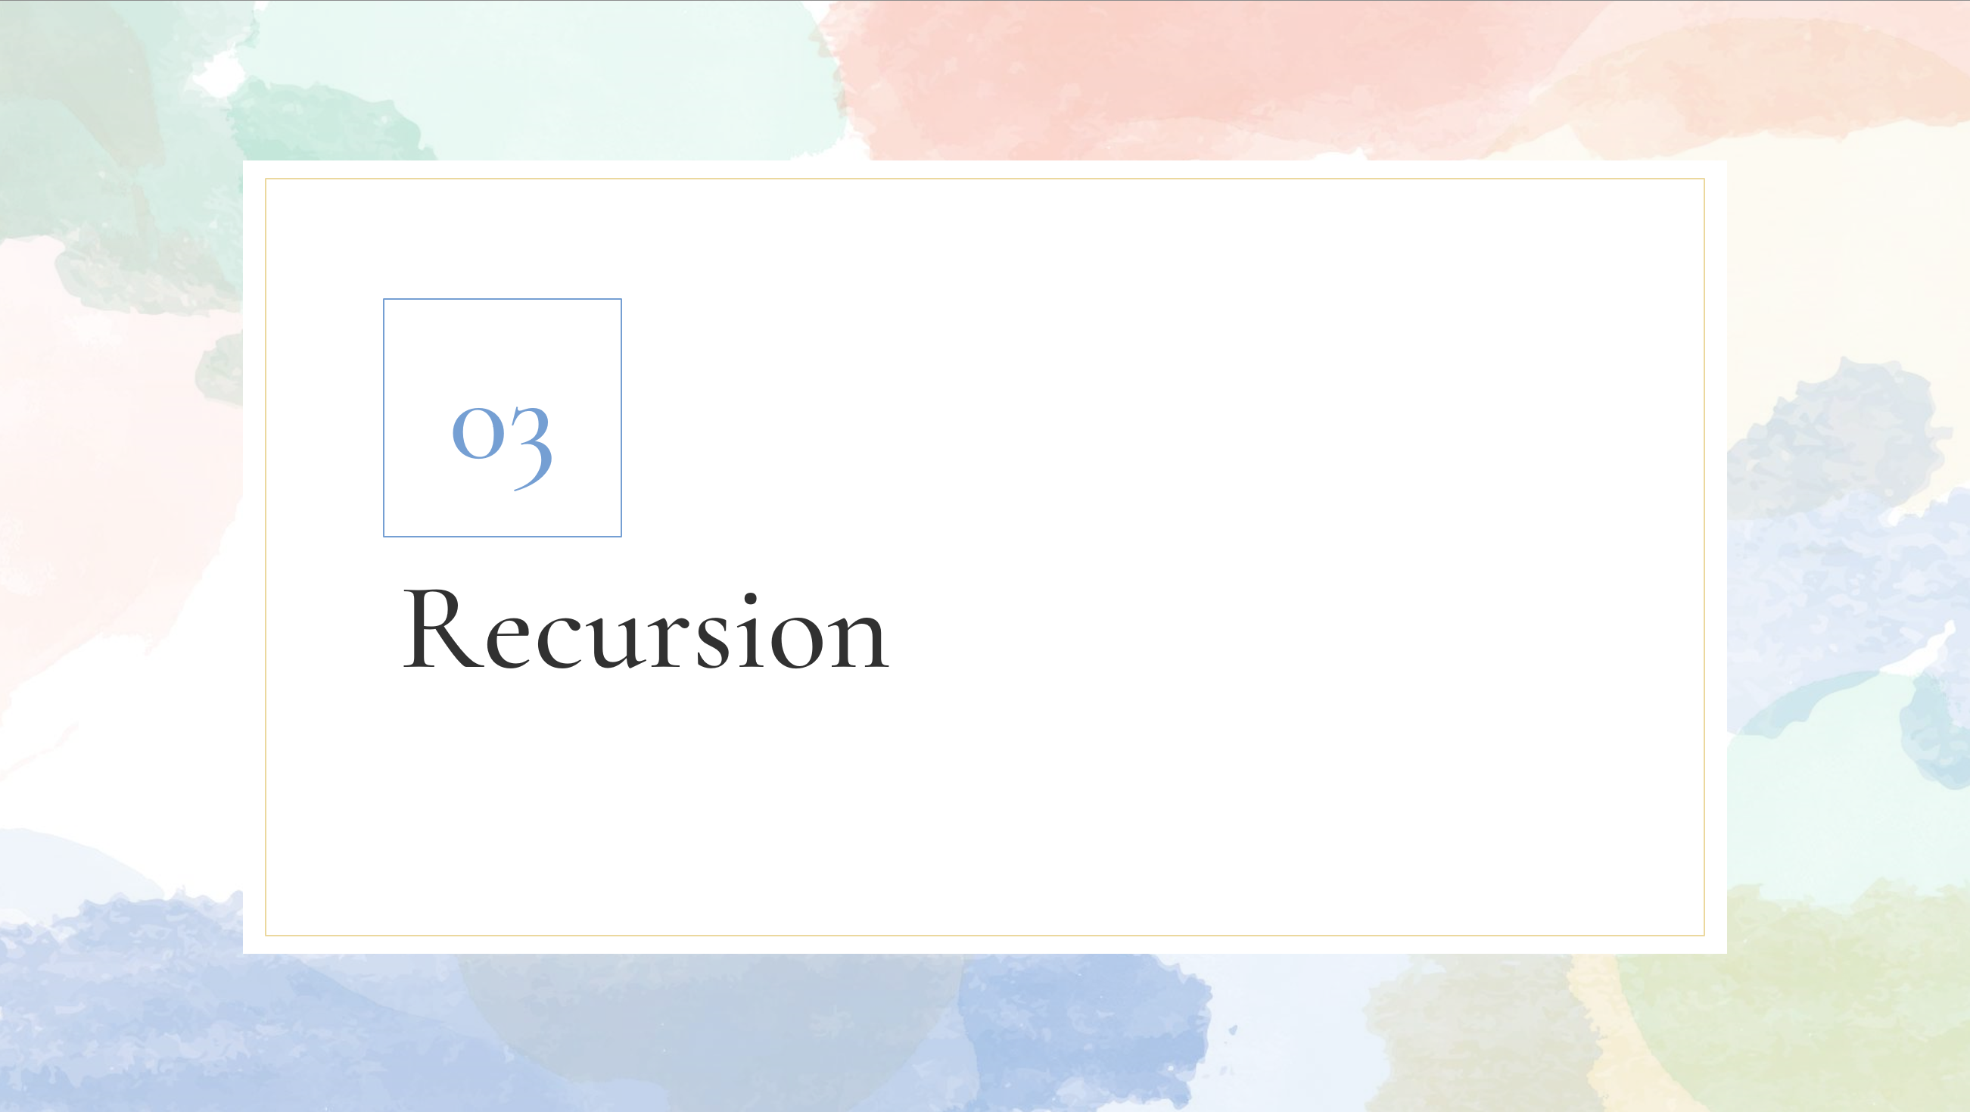
03
Recursion

Slide 31
The classic example
Recursion
5! = 5 * 4!
5! = 5 * (4 * 3 * 2 * 1)

Slide 32
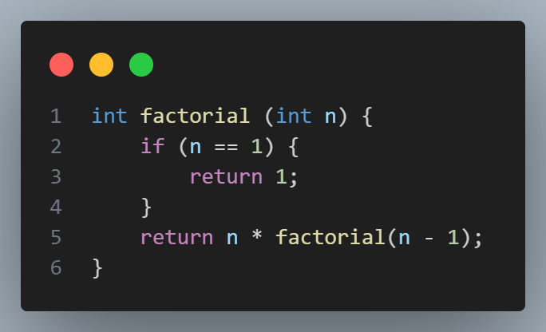
The classic example
Recursion

Slide 33
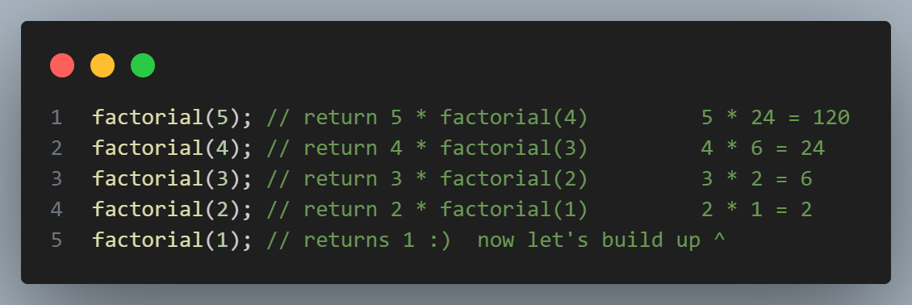
Walking through factorial
Recursion
Recursion

Slide 34
Key parts of recursive functions
Recursion
BASE CASE: something to stop recursing forever!
Recursive part: something to recurse sometimes!

Slide 35
Depth-First Search
Recursion
Let’s imagine we wanted to check if the number 4 was in this tree…
1
7
9
4
0
4
8

Slide 36
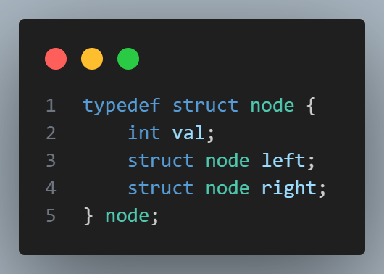
Quiz!
Recursion
Is this a good way of representing the previous problem? Discuss!

Slide 37
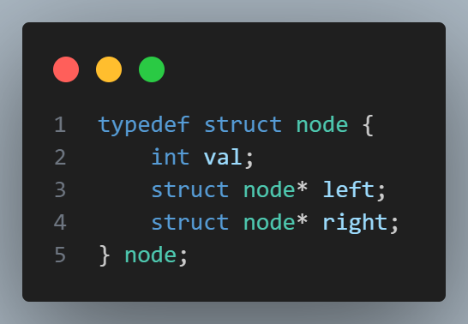
Pointers!
Recursion
We can’t store structs within structs! But we can store address to other structs to allow us to link them together!

Slide 38
tree_search.c
Recursion, pointers & structs demo!

Slide 39
Things to think about from tree_search.c
Recursion
Where were the base cases in my functions?
Was there a pattern? Did base cases come first? Last? Doesn’t matter?

Slide 40
Things to take from tree_search.c
Recursion
Recursion actually incredibly useful!
malloc to allocate memory that doesn’t die after function ends – memory on the HEAP.
Malloc’d memory must be free’d!
Pointers store address. Create using type*, you can access the underlying data using *variable.

Slide 41
04
PSET
Week ahead

Slide 42
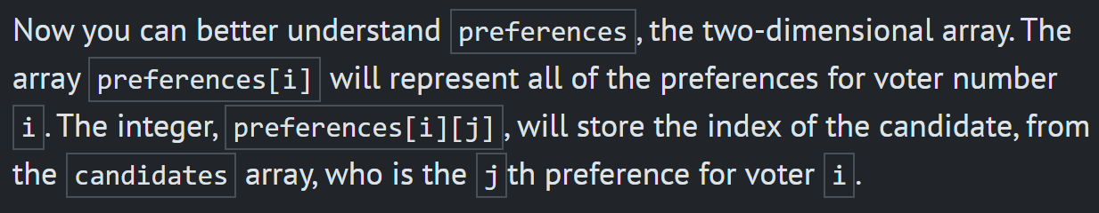
PSET info
PSET
Tideman is, in most people’s opinions, the largest jump from less comfortable to more comfortable PSET options. Be wary, it is tricky and will take some conceptual thinking. You guys can do it I’m sure, but be warned.
In Runoff, what does preferences[i][j] signify?

